Slide 1
Community Services Annual Report
2024-2025
Published May 2025

Slide 2
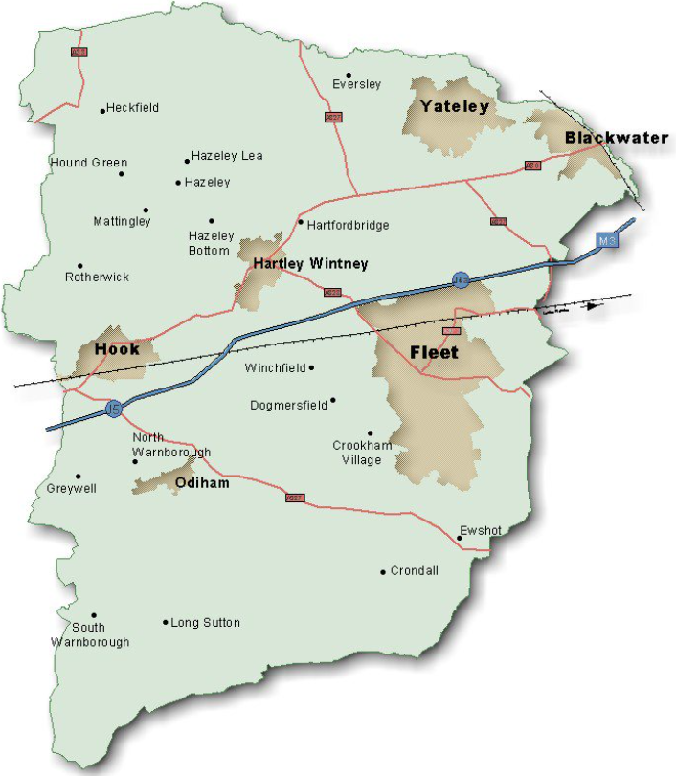
Contents
- Introduction
Key Achievements
Events Throughout 2024-2025
Partnership Working
Grant Funding
Further Information

Slide 3
Introduction
The purpose of this report is to provide an update on the activities and achievements of the Community Services Team for the year April 2024 to March 2025. It contains details about some of the exciting projects and unusual activities that colleagues have been working on, as well as giving a flavour of the day-to-day business of the various teams. It is a celebration of the work of the Community team throughout the year.
We hope you enjoy reading it.

Slide 4
Key Achievements 2024 - 2025: Private Sector Housing Team
The teams' two DFG Caseworkers passed Trusted Assessor Level 4 Training – allowing them to carry out assessments for clients requiring simple adaptations. Thus freeing up HCC occupational therapist's time for more complex clients and reducing waiting lists.
A first Empty Homes specific strategy was published and Cabinet agreement received for more robust enforcement tools. The first 'enforced sale' of an abandoned property is currently nearing completion.
-
Delivered 58 Disabled Facilities Grants (DFGs) and Prevention Grants with a total spend of more than £700,000. These grants allow vulnerable residents to continue to live independently and safely in their own homes.
Led on the removal of two unauthorised traveller encampments from Council land, as many as in the previous 5 years combined. Supported by colleagues from community safety and our shared legal service.

Slide 5
Key Achievements 2024 - 2025: Strategy & Development Team
Over 100 people attended a Low-Cost Home Ownership event in October for local people to access a one-stop shop for advice and information about shared ownership products.
In partnership with the planning team, enabled 436 affordable homes over the last 3 years, against a 3- year rolling target of 300. These comprised of 270 for rent and 166 for shared ownership.
-
Worked in partnership with the Government, Hampshire County Council and a local RP to deliver 2 more additional homes for Ukraine households under the LAHF scheme.
Worked closely with Planning Policy colleagues to help write an affordable housing Supplementary Planning Document (SPD) with a focus on delivering Social Rent homes.
Carried out extensive and detailed work around the options to remodel Heathlands Court, Hart's temporary accommodation to arrive at a preferred option for the Council to consider.
Worked in partnership with VIVID Housing Association to purchase three additional 4 -bedroom family homes to help alleviate some of the increasing need on the Hart Housing Register for this size of property .

Slide 6
Key Achievements 2024 - 2025: Housing Business Support
577 new housing register applications were processed in 24/25 showing a slight increase when compared to 555 last year.
An average of 440 emails responded to every month, (based on the last 6 months only) compared to an average of 600 over 12 months last year.
-
60 private sector grant applications processed and approved, and 73 completed and closed.
Support provided in person and over the telephone to help customers to complete their housing register application forms.
Helped manage the Hart Housing Register and provided support to the 1,686 households on the housing register as of 24.4.25.

Slide 7
Key Achievements 2024 - 2025: Housing Solutions Team
Successfully assisted 65 households in securing affordable and suitable accommodation in the private sector, representing a 24% increase in the number of households supported compared to the 2023/24 period.
Hosted a successful training event for landlords, along with a landlords' forum, focusing on the impacts of the Empty Homes Strategy and the Renters Reform Bill. This ensured that the landlords we work with are up to date on the latest legislation
229 social housing properties were advertised and allocated through Hart’s Housing Register
Housing advice was provided to 743 individual households facing homelessness, this year.
Awarded Hardship grants of over £40,000 to some of the most vulnerable households in the district

Slide 8
Key Achievements 2024 - 2025: Community Partnerships & Projects Team
Attained the Employers Recognition Scheme Silver Award from the Armed Forces Covenant
Launched a renewed Carers strategy which has widened our reach with local carer organisations and resulted in robust co-production of carer support
Organised the first HDC Employment Fair with 30 organisations and 225 residents attending
Through Public Health funding, worked with 3 charities to deliver support to children and young people who have been most affected by Covid restrictions
Continued to support Ukrainian guests settle into Hart. One to one work was undertaken to help with visas, benefits, employment and renting in the private sector
Awarded £53,000 of funding across the Winter Cost of Living Grant and the Armed Forces Community Support Grant

Slide 9
Key Achievements 2024 - 2025: Community Safety Team
A significant increase to 1,189 antisocial behaviour complaints processed including 487 received directly, the remainder received via the Police contact centre.
778 early interventions including 43 formal (ASB Warning Letters, Acceptable Behaviour Agreements, Good Neighbour Agreements or Mediation referrals) and 735 informal (signposting or advice given).
Greater focus on early intervention work and use of Community Impact Surveys has prevented the need for any Community Protection Warnings/Notices, Closures or Civil Injunctions in the 2024/25 period.
Coordination of a Hart Joint Domestic Abuse Related Death Review (DARDR) / Safeguarding Adult Review (SAR) and processing of 33 referrals for individuals needing support.
29 deliveries including Community In Motion active bystandership training offered to agencies, businesses and residents; and, Stay Safe to the 5 Hart secondary schools (including Parent evening sessions) covering Child Criminal Exploitation (CCE), knife crime awareness, domestic abuse and antisocial behaviour.

Slide 10
Key Achievements 2024 - 2025: Parking & Environmental Enforcement
Car Park income of £1,091,675 from a combination of cash in machines, the
MiPermit App, Chip and Pin and Season Ticket sales across 15 car parks.
2,894 Parking Charge Notices (PCNs) issued.
Maintenance and improvement works completed in Victoria Road, Gurkha Square, Monachus Lane car parks.
7,617 patrols undertaken. These are visits to car parks across the district for the purpose of enforcement as well as follow up on reported abandoned vehicles. 367 abandoned vehicle reports were received.
Environmental Enforcement Officer successfully recruited and service set up inhouse. 91 Fixed Penalty Notices issued for
a range of offences including littering and smoking offences under the Health Act.

Slide 11
Key Achievements 2024 - 2025: Environmental Promotions
Planted 68 Specimen Trees, 2 mini-forests, and 2 Community Orchards to help towards our climate change goals to increase carbon capture and canopy cover.
The Active Area at Edenbrook Country Park has been improved with the addition of:
A 440m skills adventure trail, with bridges & rollers.
A Drops Zone trail with progressive drops to 90cm.
Beginners flow trail for new riders
Beginners sports track for anything with wheels, including skateboards, scooters & wheelchairs.
Callisthenics exercise equipment, suitable for all levels of experience.
The first installation of our new signage suite has happened at Whitewater Meadows, with further sites to follow through 2025.
The Flood Risk / Land Drainage function has been transferred successfully from Place. A new Officer has been recruited, who’s role includes; overseeing the management & maintenance of flood risk assets owned by the council, such as ditches and ponds, leading on Flood Alleviation Schemes, and consulting on planning applications.

Slide 12
Key Achievements 2024 – 2025 : Environmental Promotions
There are now 228 volunteers signed up​ to help maintain our Countryside sites.
91 Volunteering Sessions were run with 337 attendees​, along with 11 Corporate Volunteer Groups​ assistance.
Biodiversity Net Gain financial model and costed delivery plan developed and presented to Cabinet. Approval given to create a Habitat Bank and begin work on Countryside site improvements to create Net Gain Credits.
Over 14,000 bins were emptied across the District, and 1463 Fly Tips were cleared up. There were also 399 requests for assistance on top of Grounds & Streets BAU schedule.
New pathways to improve access at Whitewater Meadows and Fleet Pond have been built, as well as resurfacing 2 key paths on Hartley Whitney Central Commons.
Phase 1 (Baseline Surveys) of our 'Plan for Fleet Pond' was completed, and Phase 2 (Design of Plan) is well underway. The data collection & analysis is complete ready for project designs, to be reviewed through 2025, with Phase 3 (Implementation) from 2026.

Slide 13
Events Throughout 2024-2025
May ’24
Awarded the Armed Forces Covenant Employers Recognition Silver Award in Portsmouth
June ’24
Countryside Stall @ Yateley Lions Fun Fest and Hook Summer School Fair
Bark in the Park @ Edenbrook Country Park
New Bike Track Launch Event @ Edenbrook Country Park
July ’24
Nature Discovery Day @ Edenbrook Country Park
Delivered County Lines interactive session to Frogmore Parents
August ’24
Sponsored the Ukrainian Independence Day celebrations in Hook
Wickham Place Community Safety event with VIVID, Police and Fire services
September ’24
Delivered a successful Employment Fair
Delivered FireWise session to Vision4Youth in Yateley

Slide 14
Events Throughout 2024-2025 contd
October ’24
Held a Carers event, bringing together all local carer organisations
Low-Cost Home Ownership event at the Harlington to provide a one-stop advice shop for local people looking into home ownership using shared ownership offerings
Delivered Knife Crime Awareness session to Fleet Pheonix
November ’24
Our first Landlords and Empty Homes Forum to bring together Landlords old and new to look at legislation and tenancy sustainability
Hart Shopping Centre Community Safety event
December ’24
Festive Wreath Making @ Queen Elizabeth II Fields
February ’25
Delivered Community in Motion training
March ’25
Delivered Community in Motion training (31 attendees)
Sycamore Grange Older Persons Community Safety event and Church Crookham Women's Institute Community Safety event
Landlords Training and awareness session to ensure they are up to date and ready for the Rents Reform Bill
9 Health/Education Walks across Hart's Countryside Sites throughout the year (209 attendees)

Slide 15
Partnership Working
Community Safety continue to work with schools, local groups, Housing Providers, Police, Fire, Health and Probation as well as youth organisations Vision4Youth and Fleet Phoenix on a range of issues.
Here for Hart continues to be a flagship community partnership working group, attended by a wide range of local third sector organisations and statutory services.
Housing Strategy and Development continues to support several parish councils to identify and deliver rural exception sites in their areas.
Worked closely with Oakley Health Group to implement the Here for Hart Directory into their surgeries
To gain the Employers Recognition Silver Award we worked closely with the Reserve Forces’ and Cadets’ Association.
Countryside along with Thames Basin Heaths Partnership organised a series of visits to Elvetham Heath Nature Reserve for 134 local schoolchildren and teachers.
Worked closely with Hart Voluntary Action to ensure the Community Garden at Edenbrook continues to be a success.
Fleet Pond Society volunteers have provided an additional 3,500 man-hours of work to help with conservation works on site, along with running educational events for 220 young persons.

Slide 16
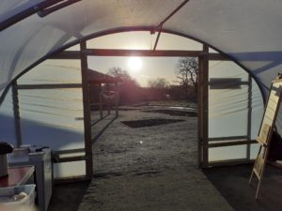
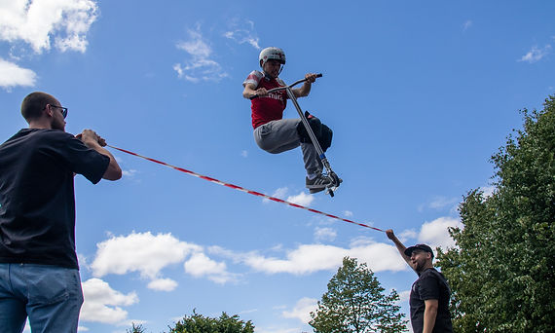
Grants
Winter Grant awarded to 10 local organisations providing services to residents due to the Cost of Living Crisis
Armed Forces Community Support Fund awarded to 6 organisations supporting cadets and veterans
3 Children and Young People's charities received funding to help support those most effected by COVID lockdown
A grant was provided to Citizens Advice to help fast-track applications for individuals experiencing significant debt issues.
Funding provided to Fleet Lions Community Store to facilitate the delivery provision of furniture and essentials to those in need.
Secured Government Local Authority Housing Fund (LAHF) grant to deliver 8 properties for Ukraine and Afghan families receiving support under Government schemes.
5 Countryside Community Grants totalling £26k have been awarded for projects which bring health, wellbeing and biodiversity benefits to residents.

Slide 17
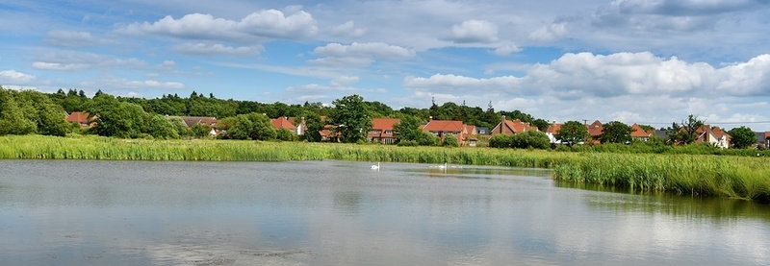
Further Information
If you would like to find out more about the Community Services Team or any of the Community Services functions, please do not hesitate to contact us via e-mail at housing@hart.gov.uk or countryside@hart.gov.uk or by calling 01252 774420

