Slide 1
Community Services Annual Report
2023-2024
Published May 2024

Slide 2
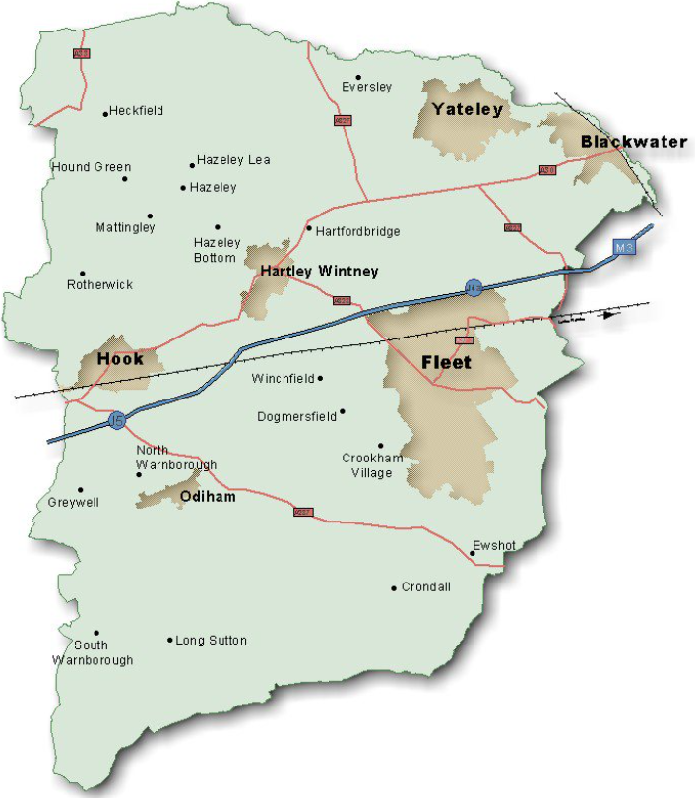
Contents
- Introduction
Key Achievements
Events Throughout 2023-2024
Partnership Working
Grant Funding
Further Information

Slide 3
Introduction
The purpose of this report is to provide an update on key activities and achievements of the Community Services Team from 1st April 2023 to 31st March 2024 within the context of national issues and local factors relating to Hart.
Throughout the last year, the Community Services Team have been working hard to continue delivering high quality services to Hart residents within Government guidelines and defined budgets.

Slide 4
Key Achievements 2023 - 2024: Private Sector Housing Team
Delivered 80 Disabled Facilities Grants (DFGs) to provide adaptations for residents to enable them to continue living safely and independently in their own homes. This is an increase of 40% on the previous year.
Approved 14 applications for discretionary Prevention Grants designed for minor 'quick win' adaptations including assisting with hospital discharges. Total DFG & Prevention Grant expenditure was over £850K.
-
Renewed 16 HMO licences which is over half of Hart's entire stock (5 year licences due to 5th anniversary of legislation introduction)
Led on removal of unauthorised traveller encampment at Bramshot Farm Country Park, assisted by colleagues in legal services and countryside

Slide 5
Key Achievements 2023 - 2024: Strategy and Development Team
-
Enabled the delivery of 217 affordable homes against a target of 100 per year and an increase of 45 from 2022/23. These comprised of 104 for rent and 113 for shared ownership
Helped to deliver 12 new affordable homes on a rural exception site in North Warnborough and working with partners on 4 other potential Rural Exception Schemes
Worked in partnership with the Government, Hampshire County Council and a local RP to deliver 5 additional affordable homes for Ukraine families and 1 for an Afghan family under the LAHF scheme
Enabled the delivery of 23 accessible homes – 22 homes build to Part M4(2) of Building Regulations and 1 wheelchair user home built to M4(3) standards
Carried out a New Residents Survey to gain important feedback from the occupiers of new affordable housing which helps to inform future developments
Obtained agreement to progress a number of housing projects including potentially remodelling Heathlands Court

Slide 6
Key Achievements 2023 - 2024: Housing Business Support
Helped manage the Hart Housing Register and provided support to the 1,416 households on the housing register as of 31st March 2024
555 new housing register applications were processed
-
An average of almost 600 emails responded to every month
82 new DFG applications approved, and 77 cases closed, including complex historical cases
Support provided in person and over the telephone to help customers to complete their housing register application form

Slide 7
Key Achievements 2023 - 2024: Housing Solutions Team
225 affordable properties advertised and allocated through Hart’s Housing Register this is a 13% increase from 22/23
Housing advice given to 906 individual households between April 2023 and March 2024 this is an increase of advice to 125 more households than in 22/23
Successfully supported 58 households to access affordable suitable accommodation in the private sector an increase of 75% with an additional 25 households supported into the private sector than in 22/23
Held a successful training event for Landlords on the Renters Reform Bill to ensure Landlords we work with are up to date on all the latest legislation
Awarded Hardship grants of over £24,000 to some of the most vulnerable households in the district

Slide 8
Key Achievements 2023 - 2024: Community Partnerships and Projects Team
In partnership with Housing, aided 35 Ukrainian families to rent their first home in the UK. Provided one to one support to ensure successful tenancies
Armed Forces training delivered across the whole Council, implemented a Reservist Policy and initiated a recruitment process. Started working with local Cadet group
Here for Hart Working Group expanded to 20 organisations including local support groups, voluntary sector and statutory services. Seen as a best practice initiative across Hampshire
Produced Here for Hart and Cost of Living Bulletins for residents throughout the year and across all social media platforms
Developed a strategy to focus support in Hart's areas of need using Census data
Applied for the Armed Forces Covenant Silver Award

Slide 9
Key Achievements 2023 - 2024: Community Safety Team
318 early interventions including ASB Warning Letters, Acceptable Behaviour Agreements, Good Neighbour Agreements or Mediation referrals have taken place.
Early intervention and the use of 4 Community Protection Warnings has prevented the need for any Community Protection Notices, Closures or Civil Injunctions in 2023/24 period.
Delivery of Knife Crime Awareness session to Explorer Scouts and Youth Group around myths and dangers of carrying a knife.
916 Antisocial behaviour complaints processed including 322 received directly, the remainder received via the Police contact centre.
28 projects/training courses delivered including a promotional event to retailers around use of the DISC online reporting system which shares instantly to Police/other retailers to support tackling ASB/shoplifting and Think Safe, Stay Safe and Think Drive Stay Alive education pieces to schools on general safety matters and Child Criminal Exploitation (CCE) respectively.

Slide 10
Key Achievements 2023 - 2024: Parking Team
Car Park income of £1,080,512 from a combination of cash in machines, the MiPermit App, Chip and Pin and Season Ticket sales.
2,869 Parking Charge Notices issued across car parks, with 824 challenges, and 62 Representations
7,406 patrols undertaken. This is visits to car parks across the district, for the purpose of enforcement, and abandoned vehicles. 323 abandoned vehicle reports received.

Slide 11
Key Achievements 2023 - 2024: Environmental Promotions
228 volunteers signed up
102 Volunteering Sessions with 285 attendees
8 Corporate Volunteer Groups
Dealt with 1310 Fly Tips
Collected £27k in Litter Enforcement
We have received £200k in grant funding for biodiversity services including project £90k for biodiversity net gain readiness and £100k for practical conservation projects
2 new international Green Flags Awards were given to Edenbrook Country Parks and Hartland Country Park. Giving a record total of 6 awards this year
Tree & Woodland Strategy - delivered to enhance biodiversity, adapt and be resilient to climate change, and benefit the health and well-being of the community.
Hazeley Heath in 'favourable condition' as a SSSI. This is the highest achievable condition for our protected sites in England. This is due to 20 years of investment and partnership working with the RSPB. Projects such as fenceless grazing and our approach to public engagement was seen as nationally significant

Slide 12
Events Throughout 2023-2024
June ‘23
Low-Cost Home Ownership event to promote low-cost home ownership including shared ownership options held at the Council offices with over 150 people attending
Yateley Community Fair
Hook Schools Summer Fair & Greening Day
Aug '23
Ukraine Independence Day celebrations
BioBlitz at Edenbrook Country Park
Sept '23-
2 sessions of Landlord training around the Renters Reform Bill and to update on changes to legislation
Harvest Festival @ Hart's Green Garden
Dec '23
Ukrainian stall at Fleet Christmas Market
Mar 24
Think Safe at Calthorpe Park School
Stay Safe events in May, June and November 2023
5 Health/Education Walks across Hart's Countryside Sites throughout the year.

Slide 13
Partnership Working
The Strategy and Development team supported Action Hampshire’s successful bid for Rural Housing Enabler funding and participate in the RHE Steering Group.
Community Projects and Partnerships team continue to partner with local armed forces support organisations, strengthening our working relationships and demonstrating our commitment to the Armed Forces Covenant.
Strategy and Development officers continue to play an active role in supporting local communities and Parish Councils to bring forward rural exception sites in 5 rural areas, one of which completed recently proving new affordable homes.
Community Projects and Partnerships team grew the Here for Hart network across more organisations and facilitated partnership working across Hart, particularly youth services.
Worked with Yateley Town Council to reinstate a pond at Royal Oak Valley
Signed a Memorandum of Agreement with Odiham Parish Council
Working with the RSPB to graze cattle at Hazeley Heath

Slide 14
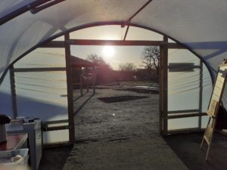
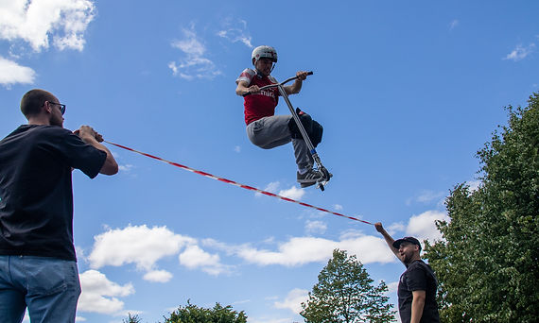
Grants
Winter Grant awarded to local organisations providing services to residents due to the Cost of Living Crisis
Central Government and Hampshire County Council funding given to enable events and projects that enhance the social integration of Ukrainian guests into our community
31 households in extreme hardship assisted with small one-off grants to help alleviate the housing related crisis with grant given by Hampshire County Council and central Government as part of the Household Support fund.
7 Countryside Grants adding up in value to £29k were awarded to help support communities to deliver projects providing health and wellbeing, biodiversity, sustainability, and educational benefits. More details can be found on Community grant winners announced | Hart District Council to apply Community grants scheme | Hart District Council

Slide 15
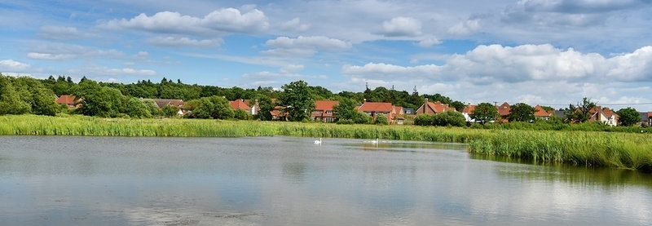
Further Information
If you would like to find out more about the Community Services Team or any of the Community Services functions, please do not hesitate to contact us via e-mail at housing@hart.gov.uk or countryside@hart.gov.uk or by calling 01252 774420.

