Slide 1
Published May 2023
Community Services Annual Report
2022-2023

Slide 2
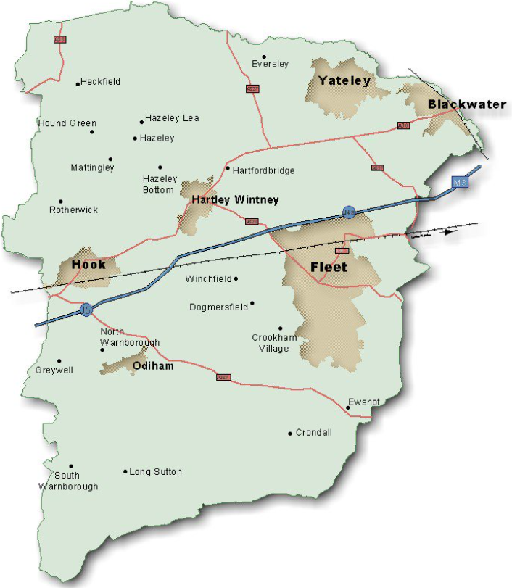
Contents
- Introduction
Key Achievements
Events Throughout 2022-2023
Partnership Working
Grant Funding
Further Information

Slide 3
Introduction
The purpose of this report is to provide an update on some of the activities and achievements of the Community Services Team from 1st April 2021 to 31st March 2022 within the context of national issues and local factors relating to Hart.
Throughout the last year, the Community Services Team have been working hard to continue delivering high quality services to Hart residents within Government guidelines.

Slide 4
Key Achievements 2022 - 2023: Private Sector Housing Team
-
Delivered 57 Disabled Facilities Grants (DFGs) to provide adaptations for Hart residents to enable them to continue living safely and independently in their own homes, with a spend of £630K.
This included 6 cases who received additional discretionary 'top-up' funding for larger works which otherwise could not have taken place. 4 of these cases involved children
Investigated 42 disrepair complaints from tenants in both the private and social rented sector. These were primarily damp & mould and excess cold complaints over the winter period
Awarded over £20K of discretionary Prevention Grant funding for fast tracked minor adaptations designed at preventing hospital admissions and assisting with hospital discharges.

Slide 5
Key Achievements 2022 - 2023: Strategy and Development Team
-
Enabled the delivery of 172 affordable homes against a target of 100 per year. These comprised of 127 for rent and 45 for shared ownership
Refreshed how adapted affordable homes are recorded to make best use of these homes going forward
Co-ordinated and lead on the successful transition of the Housing BSU staff into Community Services
Liaising with the Government and partners to set up and oversee the Local Authority Housing Fund (LAHF) scheme in Hart to deliver 9 new affordable homes
Worked with colleagues and Registered Providers to update Hart’s Designated Protected Areas guidance
Researched and produced Local Lettings Plans for complex housing projects including the LAHF and a specialist housing scheme

Slide 6
Key Achievements 2022 - 2023: Housing Solutions Team
-
269 affordable properties advertised and allocated through Hart’s Housing Register
Housing advice given to 781 individual households between April 2022 and March 2023
55 households were prevented from becoming homeless
21 households had their homelessness relieved by intervention from the Housing Team​
Work to identify the main reasons for people losing their last settled home continuing the focus of prevention of homeless

Slide 7
Key Achievements 2022 - 2023: Community Partnerships and Projects Team
Headed the Homes for Ukraine Scheme, successfully rematching 6 families with new hosts and coordinated and financed the move of 10 families into privately rented accommodation
Armed Forces Covenant Full Council Presentation and Signing of the Defence Employer Recognition Scheme Bronze Award
Here for Hart Directory launched enabling the community to search all support and leisure functions in Hart
Provided material for the Hart Cost of Living Hub and published leaflets which were delivered to GPs, Children’s Services, Town and Parish Councils and Libraries
Collaborative working with Reading Football Club to provide training in schools for challenged pupils
‘Dementia Support in Hart’ and ‘Blood Pressure Testing in Pharmacies’ information leaflets printed and distributed

Slide 8
Key Achievements 2022 - 2023: Community Safety Team
1,156 Antisocial behaviour complaints processed (including 24 repeat cases)
Early intervention has prevented the need for any Community Protection Notices, Closures or Civil Injunctions in 2022/23 period
83 early interventions including ASB Warning Letters, Acceptable Behaviour Agreements, Good Neighbour Agreements or Mediation referrals
27 projects and training courses delivered including public awareness of begging/homelessness pop-up in Fleet Road, Think Safe and Stay Safe education pieces to schools on general safety matters and Child Criminal Exploitation (CCE) respectively

Slide 9
Key Achievements 2022 - 2023: Parking Team
32,733 patrols undertaken which include visits to car parks, and on street locations across the district, for the purpose of enforcement and in response to reported parking offences which create traffic flow issues.
with 805 challenges reviewed on appeal for acceptance or rejection3,633 Parking Charge Notices issued across car parks and on street locations.
Car Park income of £837,051.95 from a combination of cash in machines, the MiPermit App, Chip and Pin and Season Ticket sales.

Slide 10
Key Achievements 2022 - 2023: Countryside
First full year of the community garden open and first year of Park Run (average of 264 finishing runners each Saturday). 192 people signed up as countryside volunteers and have run 103 volunteer days and 12 corporate volunteer days
Contract awarded for a new play area in Whitewater Meadows. Predominantly a natural play area designed to fit into the environment. Provides 10 different experiences for children from 2- 14 years and will eventually be surrounded with a community orchard
No Mow May. Multiple sites added to the areas of conservation cuts, meaning 60% of our grass being managed for nature conservation
All 3 Green Flags and 1 Green Heritage international awards retained. Applications have been submitted for a further 2 awards for Edenbrook and Hartland Park
Contacted all parish and town councils that have Hart countryside sites within them as part of the new Parish Engagement Plan. Meetings set up as part of the commitment to engage and keep the local community informed of works

Slide 11
Events Throughout 2022-2023
May ‘22: Ukraine Community Support Event (Hook). Welcoming guests to Hart and introducing them to key support organisations in the area
Jun ‘22: Ukraine Community Support Event (Fleet). Welcoming guests to Hart and introducing them to key support organisations in the area
Sept ‘22: Council Showcase Event. The Community Partnerships and Projects Team hosted a Council Showcase Event held at the Harlington for Councillors and Staff
Dec ‘22: Christmas party for Ukrainian guests
Feb ‘23: 38 landlords attended the annual Landlords Forum where guest speakers, including Hart’s Private Sector Housing Manager provided information and training to encourage more landlords to work with Hart to maximise availability of properties in the private sector.
Mar ‘23: Here for Hart Event - Armed Forces Covenant

Slide 12
Partnership Working
The Strategy and Development team play an active role in the Hampshire Enablers Network, contributing to the Hampshire Enablers First Homes working group, and its work around the new shared ownership arrangements, and Local Authority Housing Fund (LAHF) scheme.
The team continues to work with planning colleagues, Registered Providers (RPs) and developers to deliver wheelchair accessible housing and other accessible homes to meet the identified need from the housing register.
Strategy and Development officers continue to play an active role in supporting local communities and Parish Councils to bring forward rural exception sites in 4 rural areas, one of which completed recently proving new affordable homes.
Community Partnerships and Projects Team continues to manage the Here for Hart Working Group which brings together organisations providing support across Hart. These include charities, voluntary sector organisations, Citizens Advice, DWP, Public Health, armed forces and NHS.

Slide 13
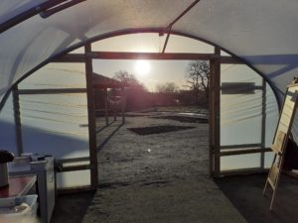
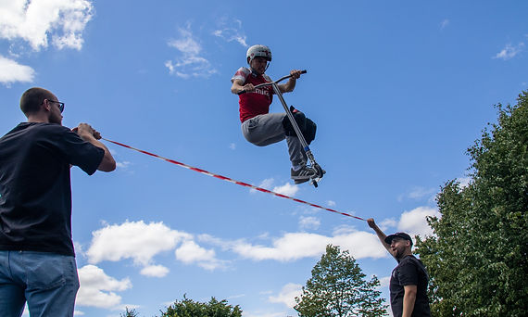
Grants
Minding the Garden supported with grants to enable the project to deliver fresh produce to the Community Pantry
Central Government and Hampshire County Council funding given to enable events and projects that enhance the social integration of Ukrainian guests into our community
31 households in hardship assisted with small one-off grants to help alleviate the crisis with grant given by Hampshire County Council and central Government
Fleet Phoenix given a grant to cover activities and support they deliver given the substantial rise in young people they support during this period
£15,000 awarded to Heatherside Infants School for a wellbeing garden from Countryside’s local enhancement funding. This is now close to completion and is providing a sanctuary to help with mental health wellbeing. Also includes a diversity area to help educate and involve students with nature at a young age

Slide 14
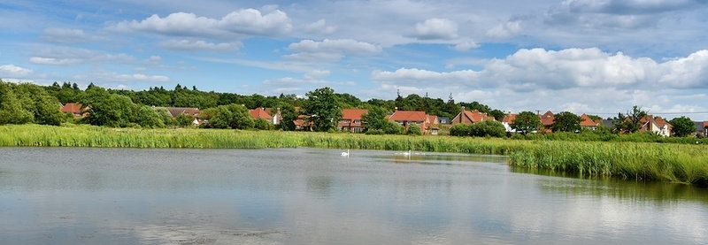
Further Information
If you would like to find out more about the Community Services Team or any of the Community Services functions, please do not hesitate to contact us via e-mail at housing@hart.gov.uk or countryside@hart.gov.uk or by calling 01252 774420.

